Slide 1
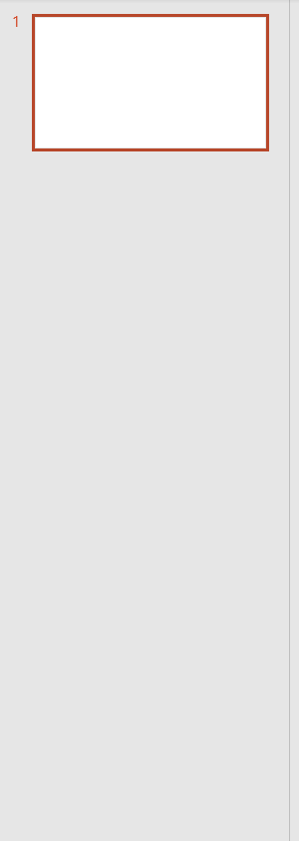


Slide 2
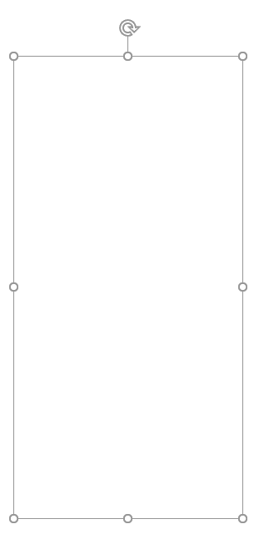
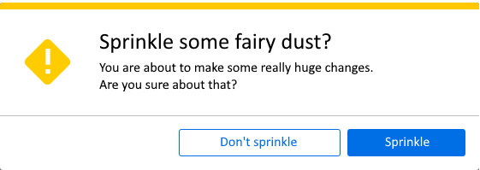

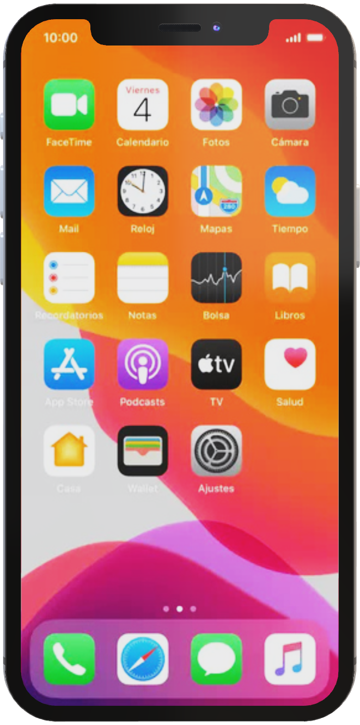

Slide 3



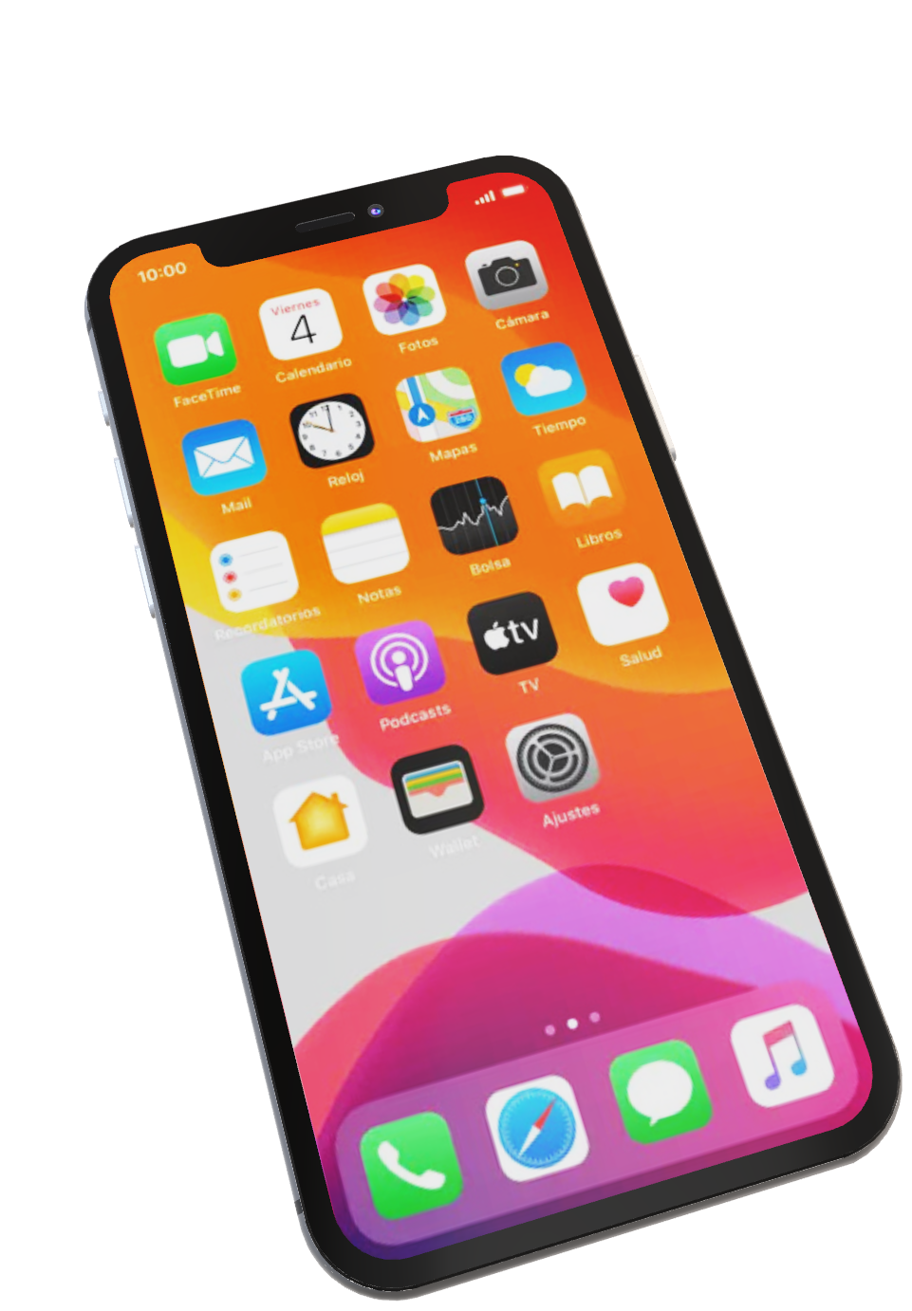
Introducing
ShopSave

Slide 4
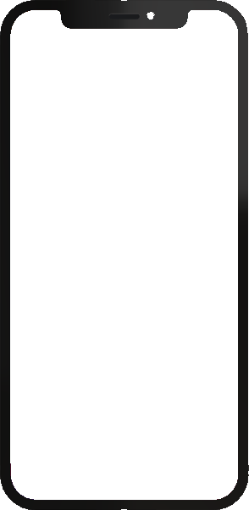
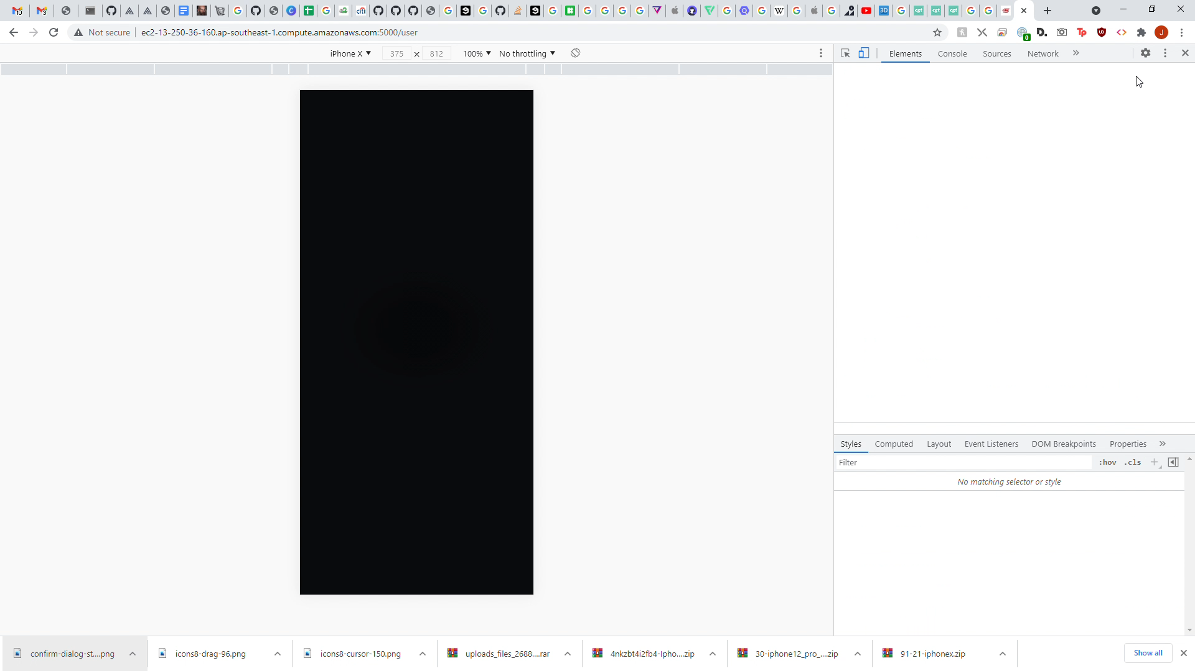








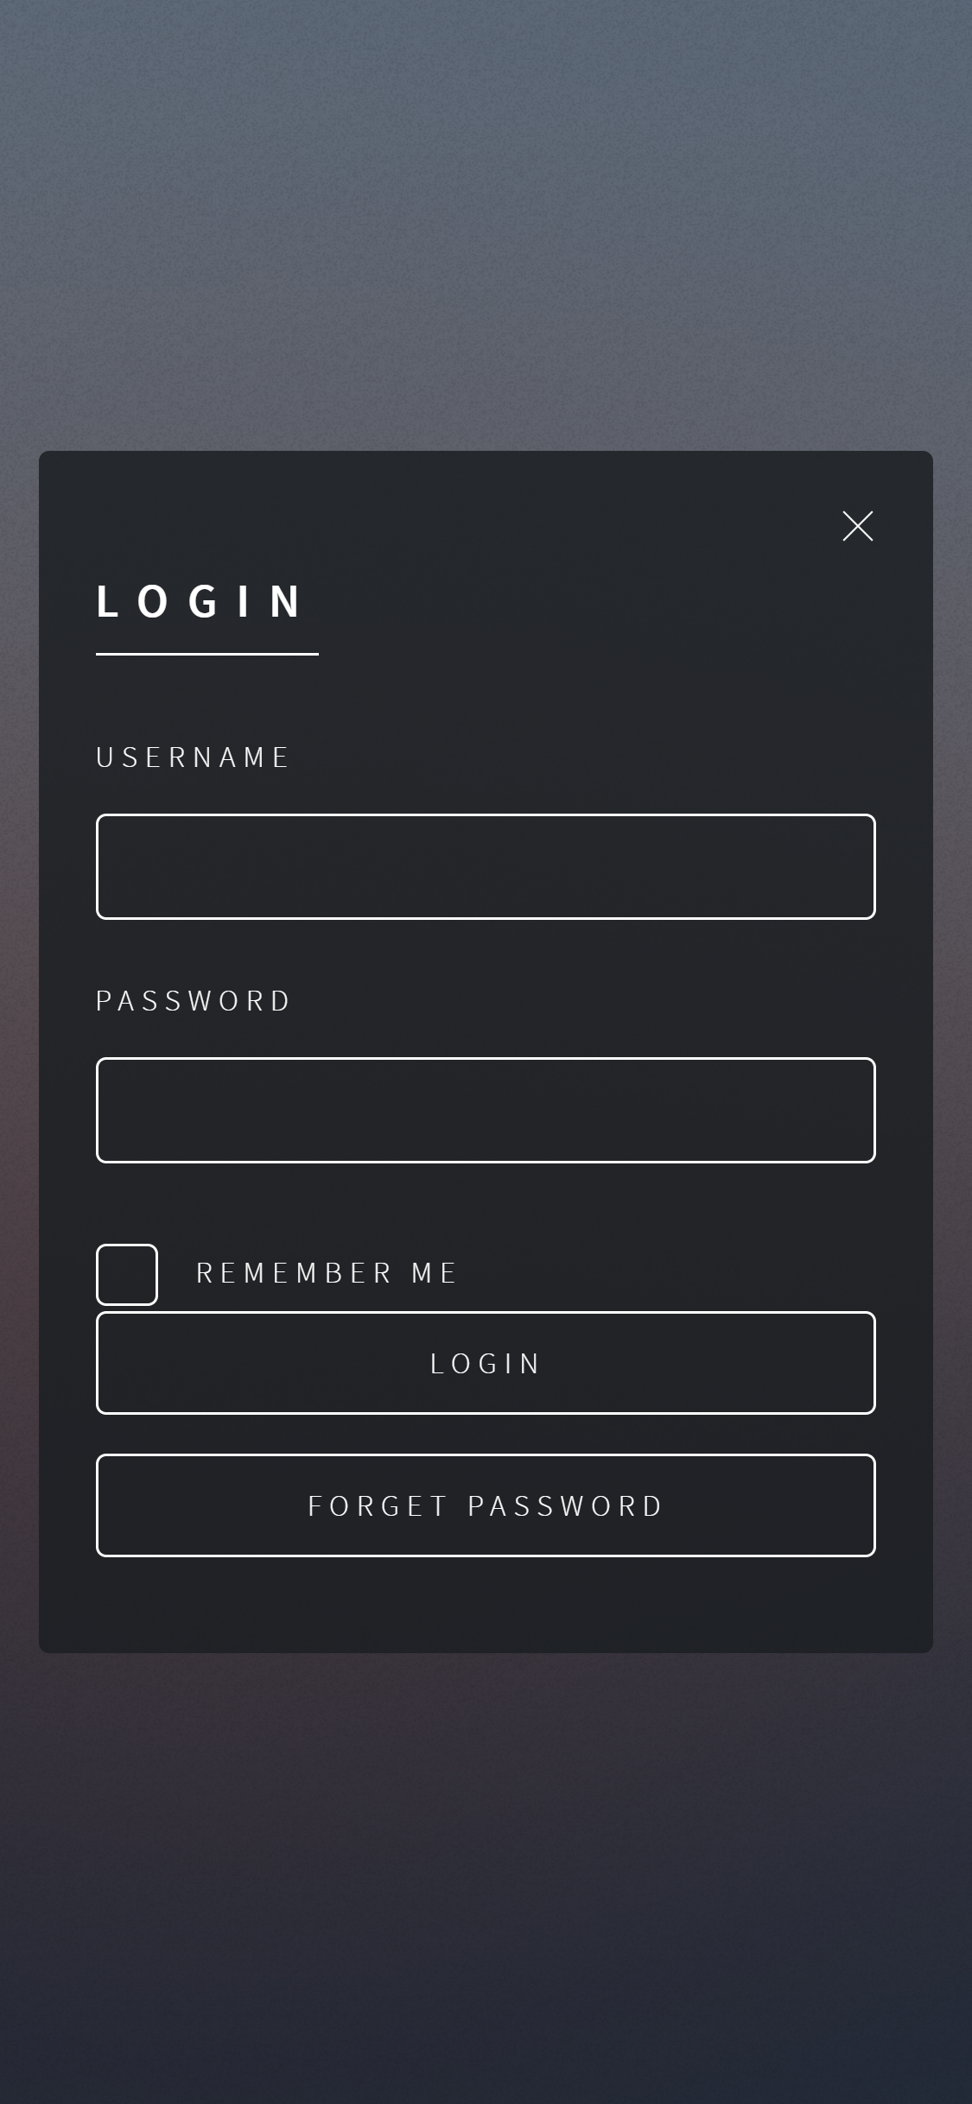
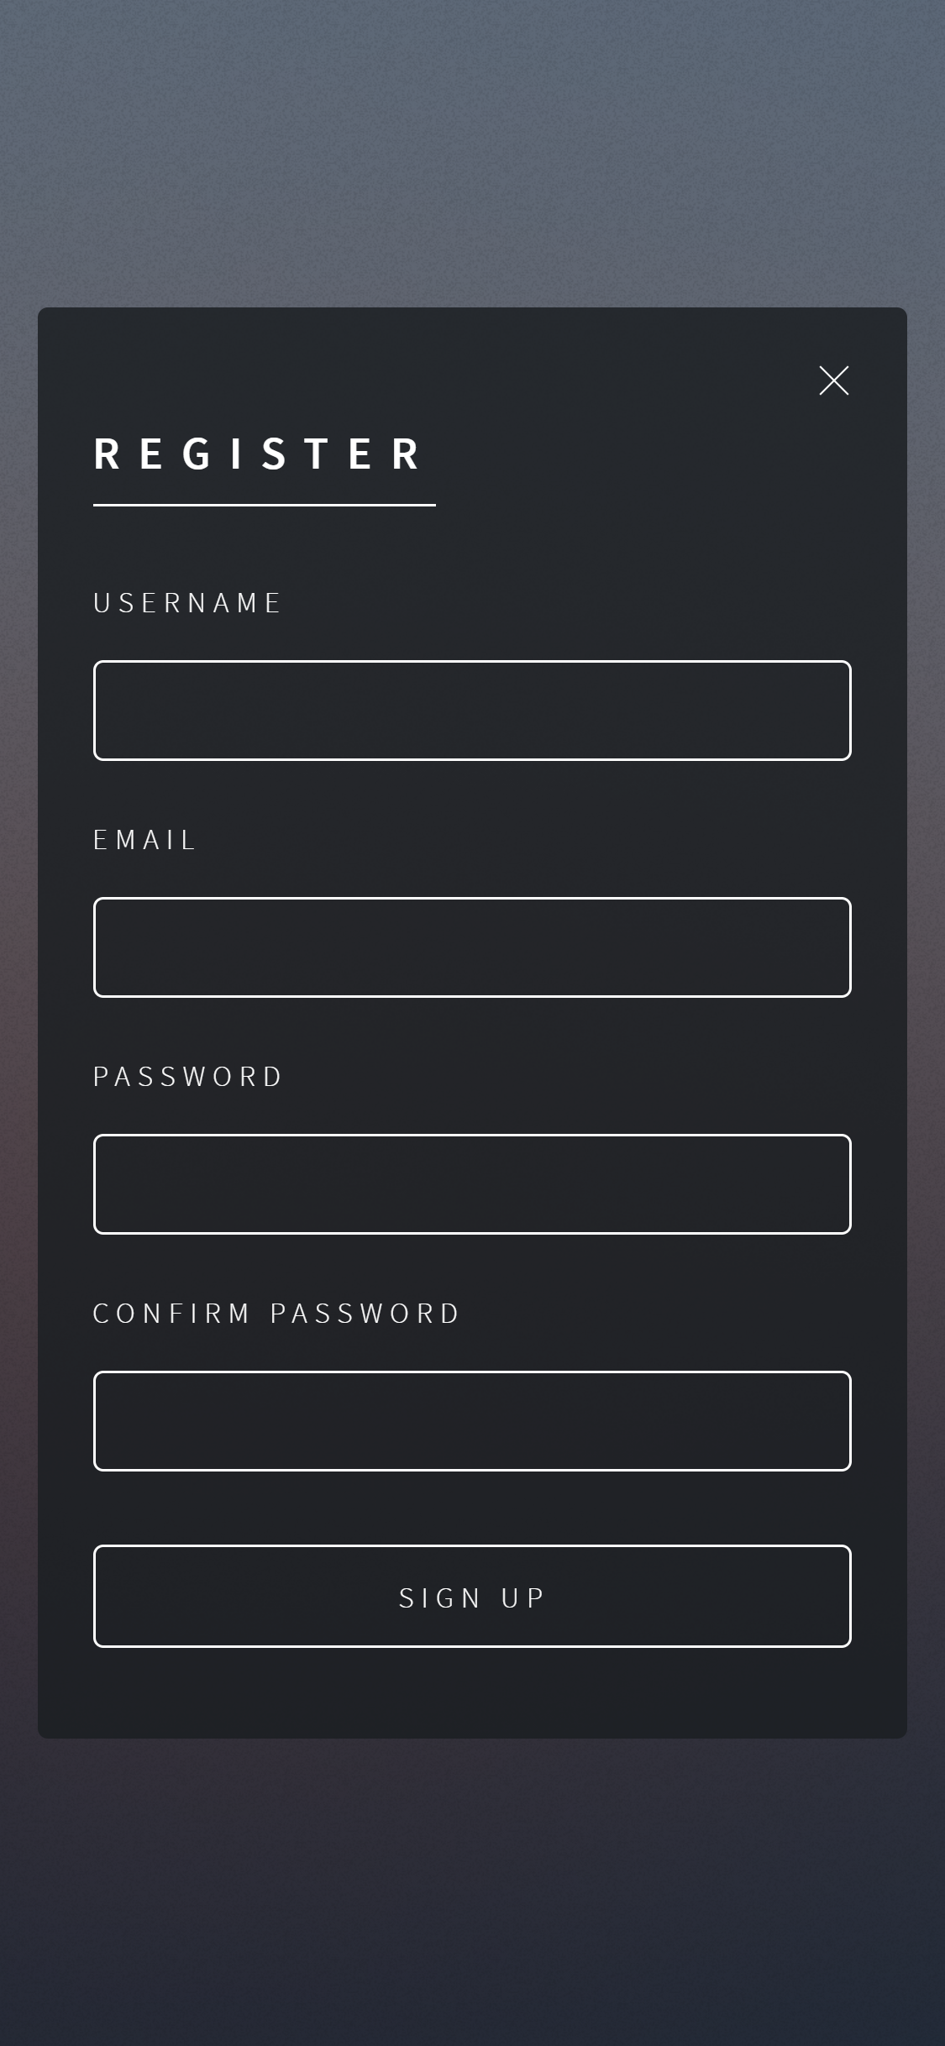
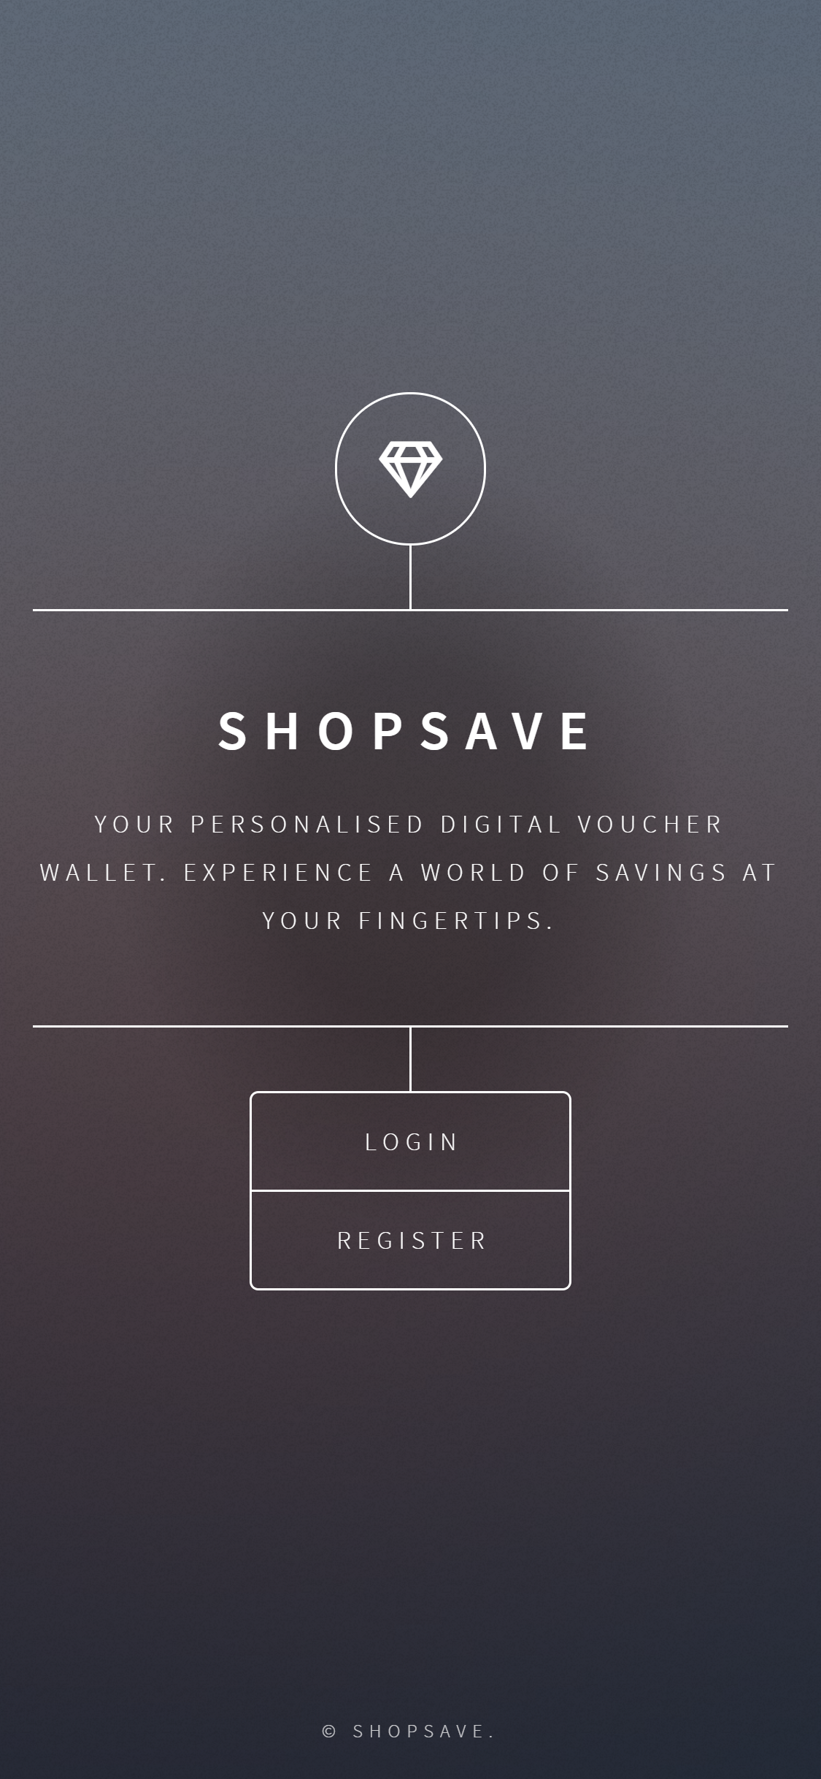
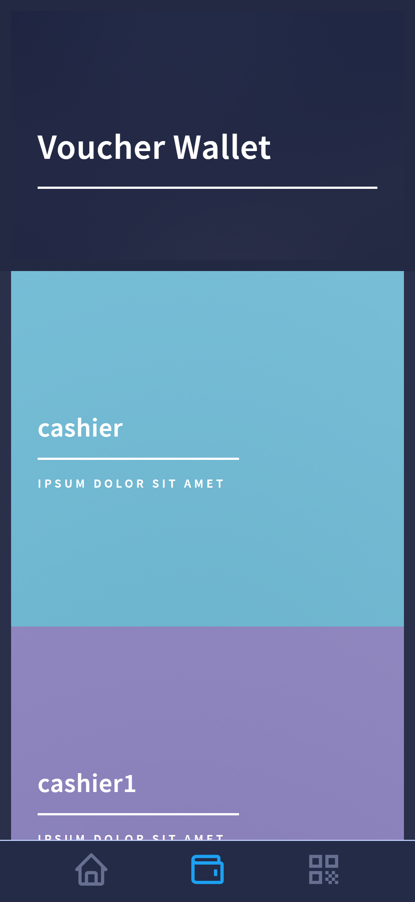
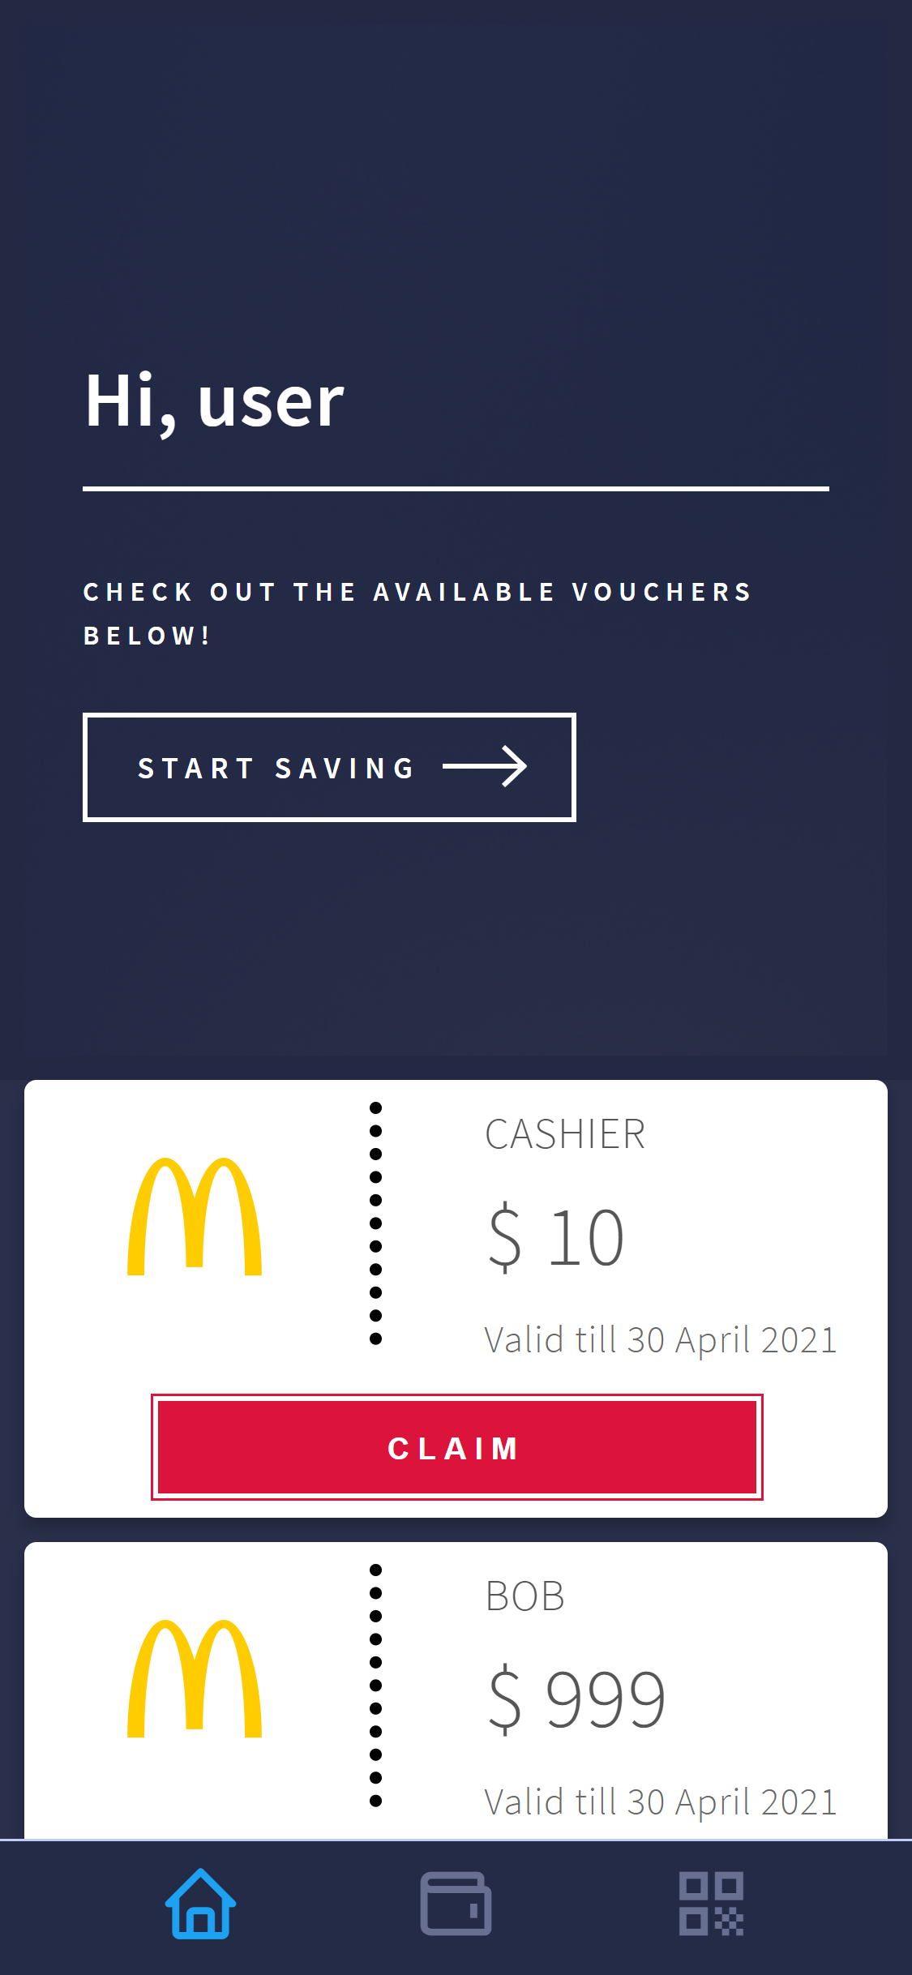
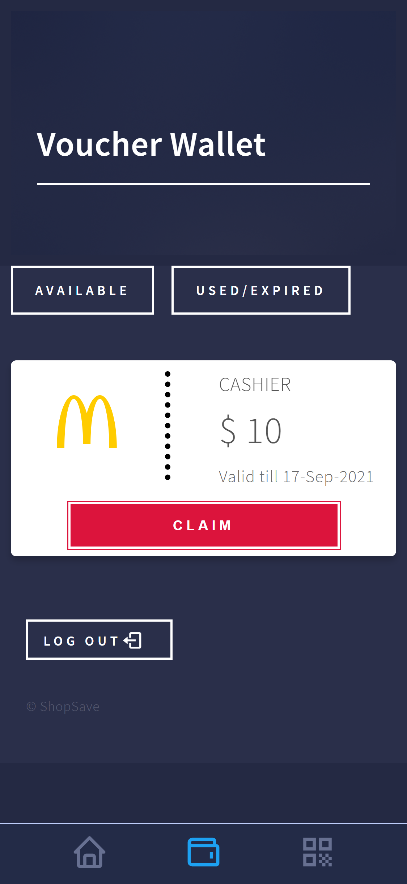
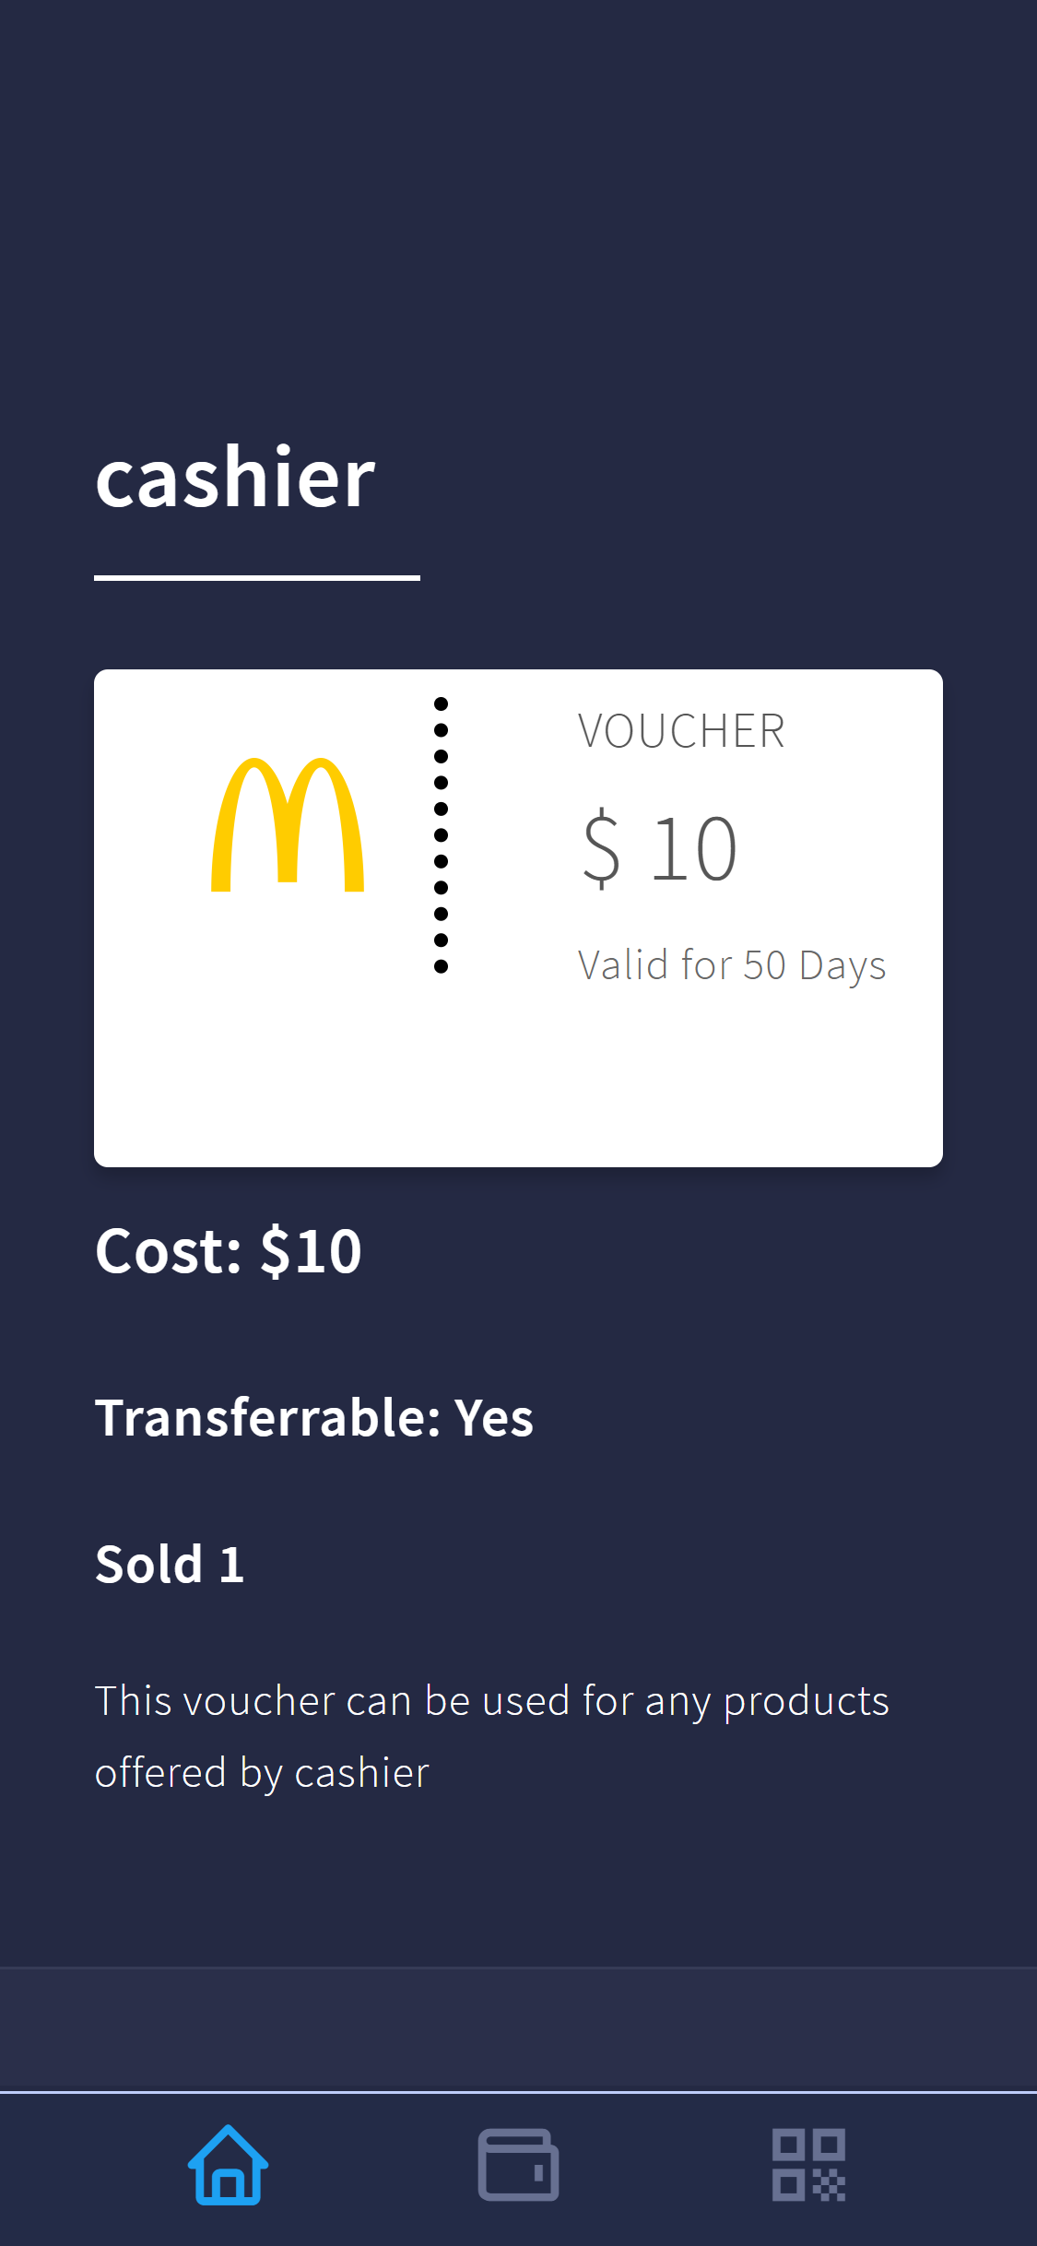
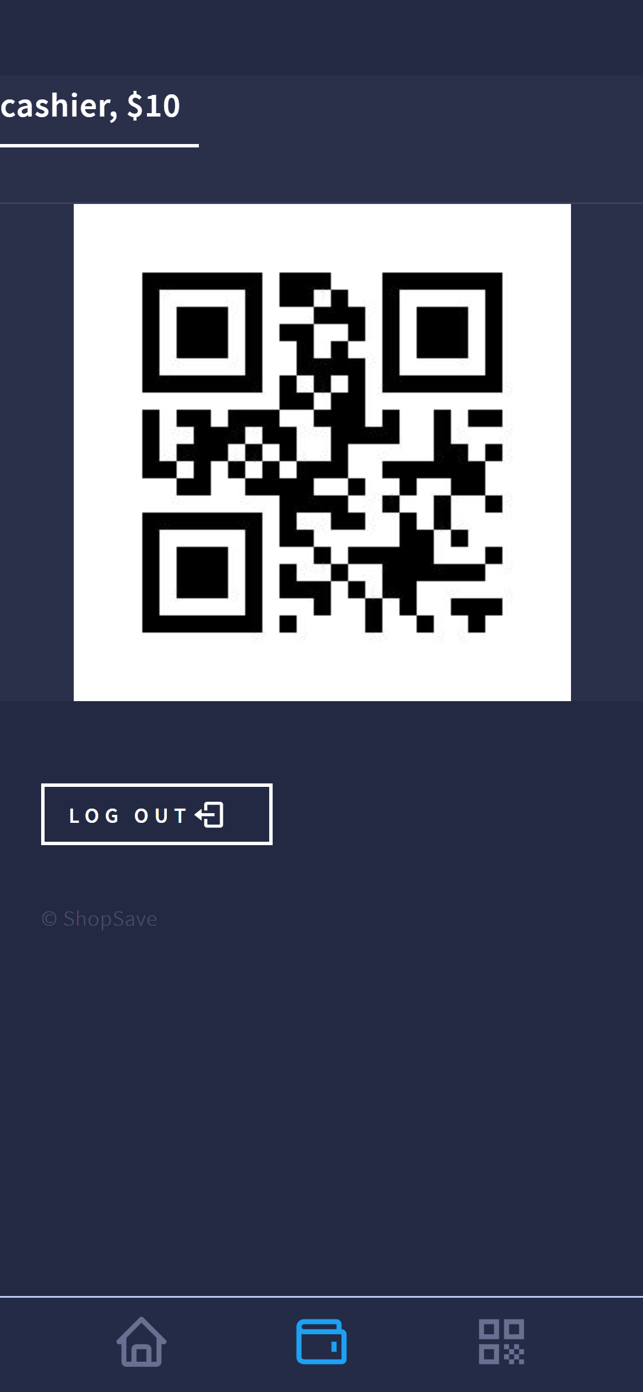

Introducing
ShopSave
Problem
Statement
UI Preview

Slide 5


Introducing
ShopSave
“…design a multi-users application to allow users to purchase QR code vouchers for offline shopping.”
Problem
Statement
UI Preview
landing page
For consumers to begin their user journey
Notes:
Problem statement - ?
Solution and UI – ui logo
Demo – present logo
Features – menu logo
Workflow Design/Architecture/technology stack – cloud logo
Project Timeline, Key Metrics, Testing – lightbulb cog wheel

Slide 6


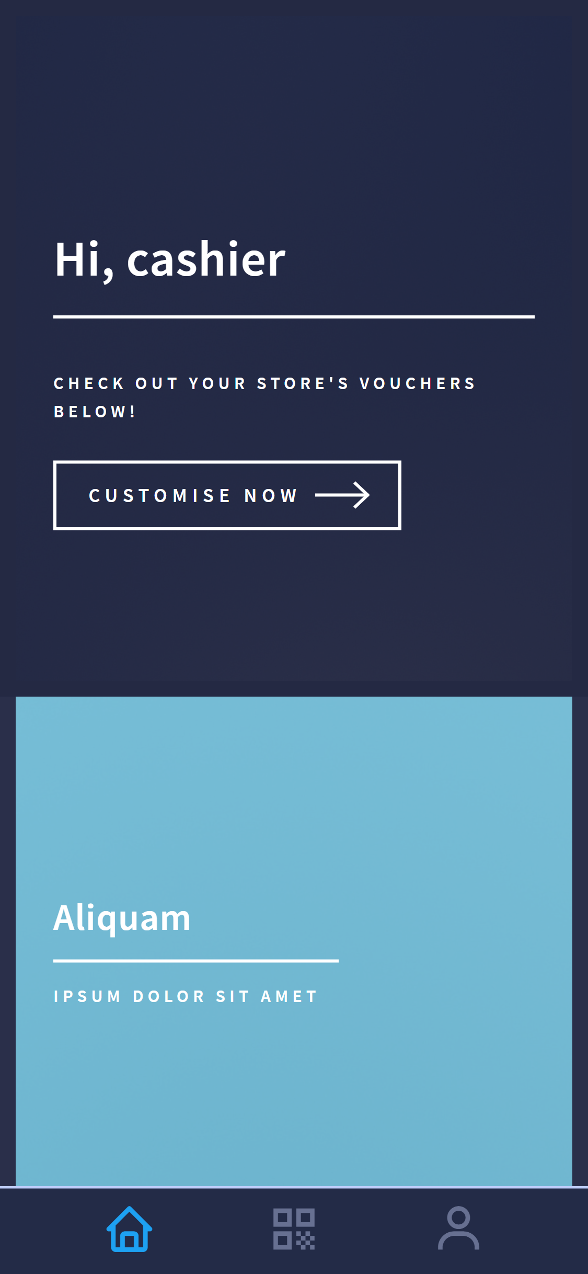
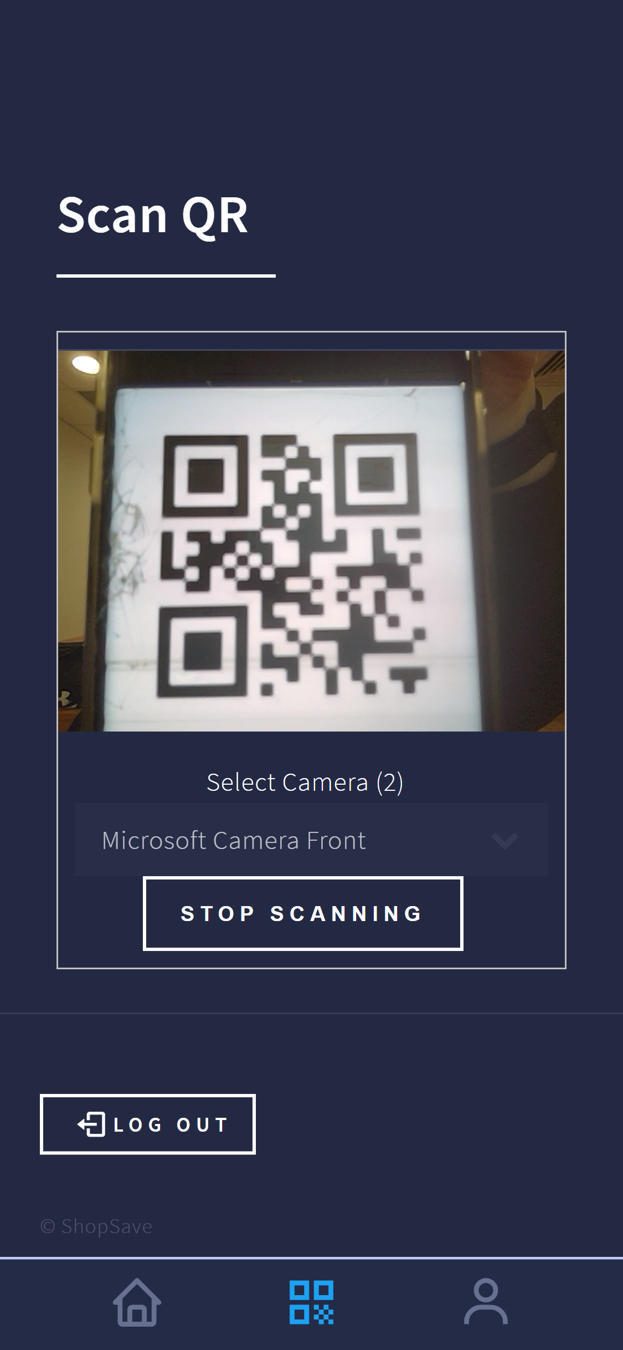
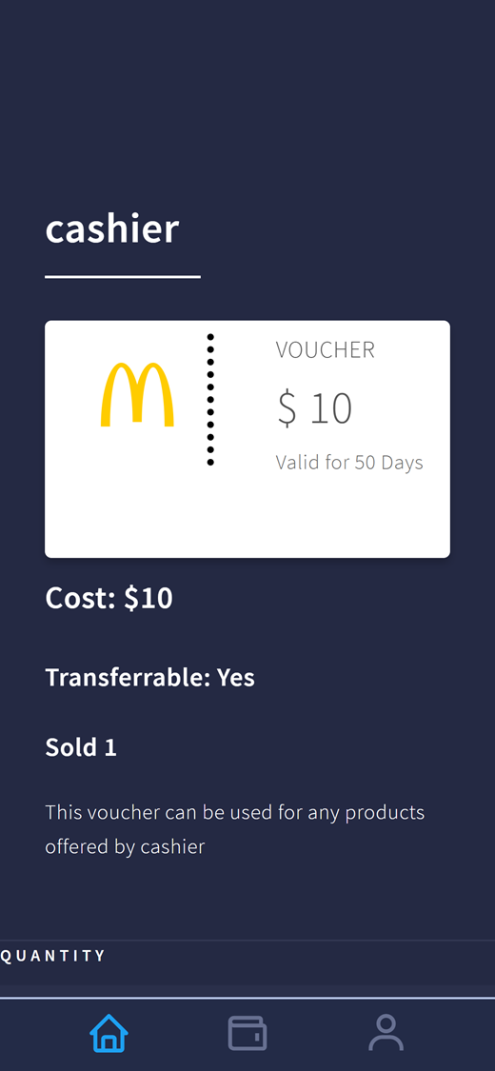
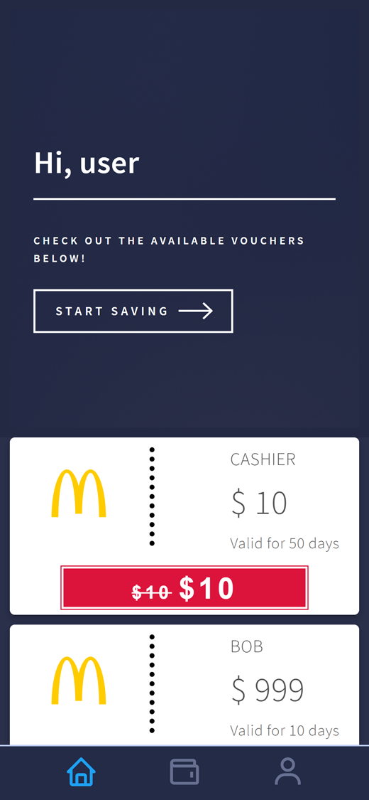
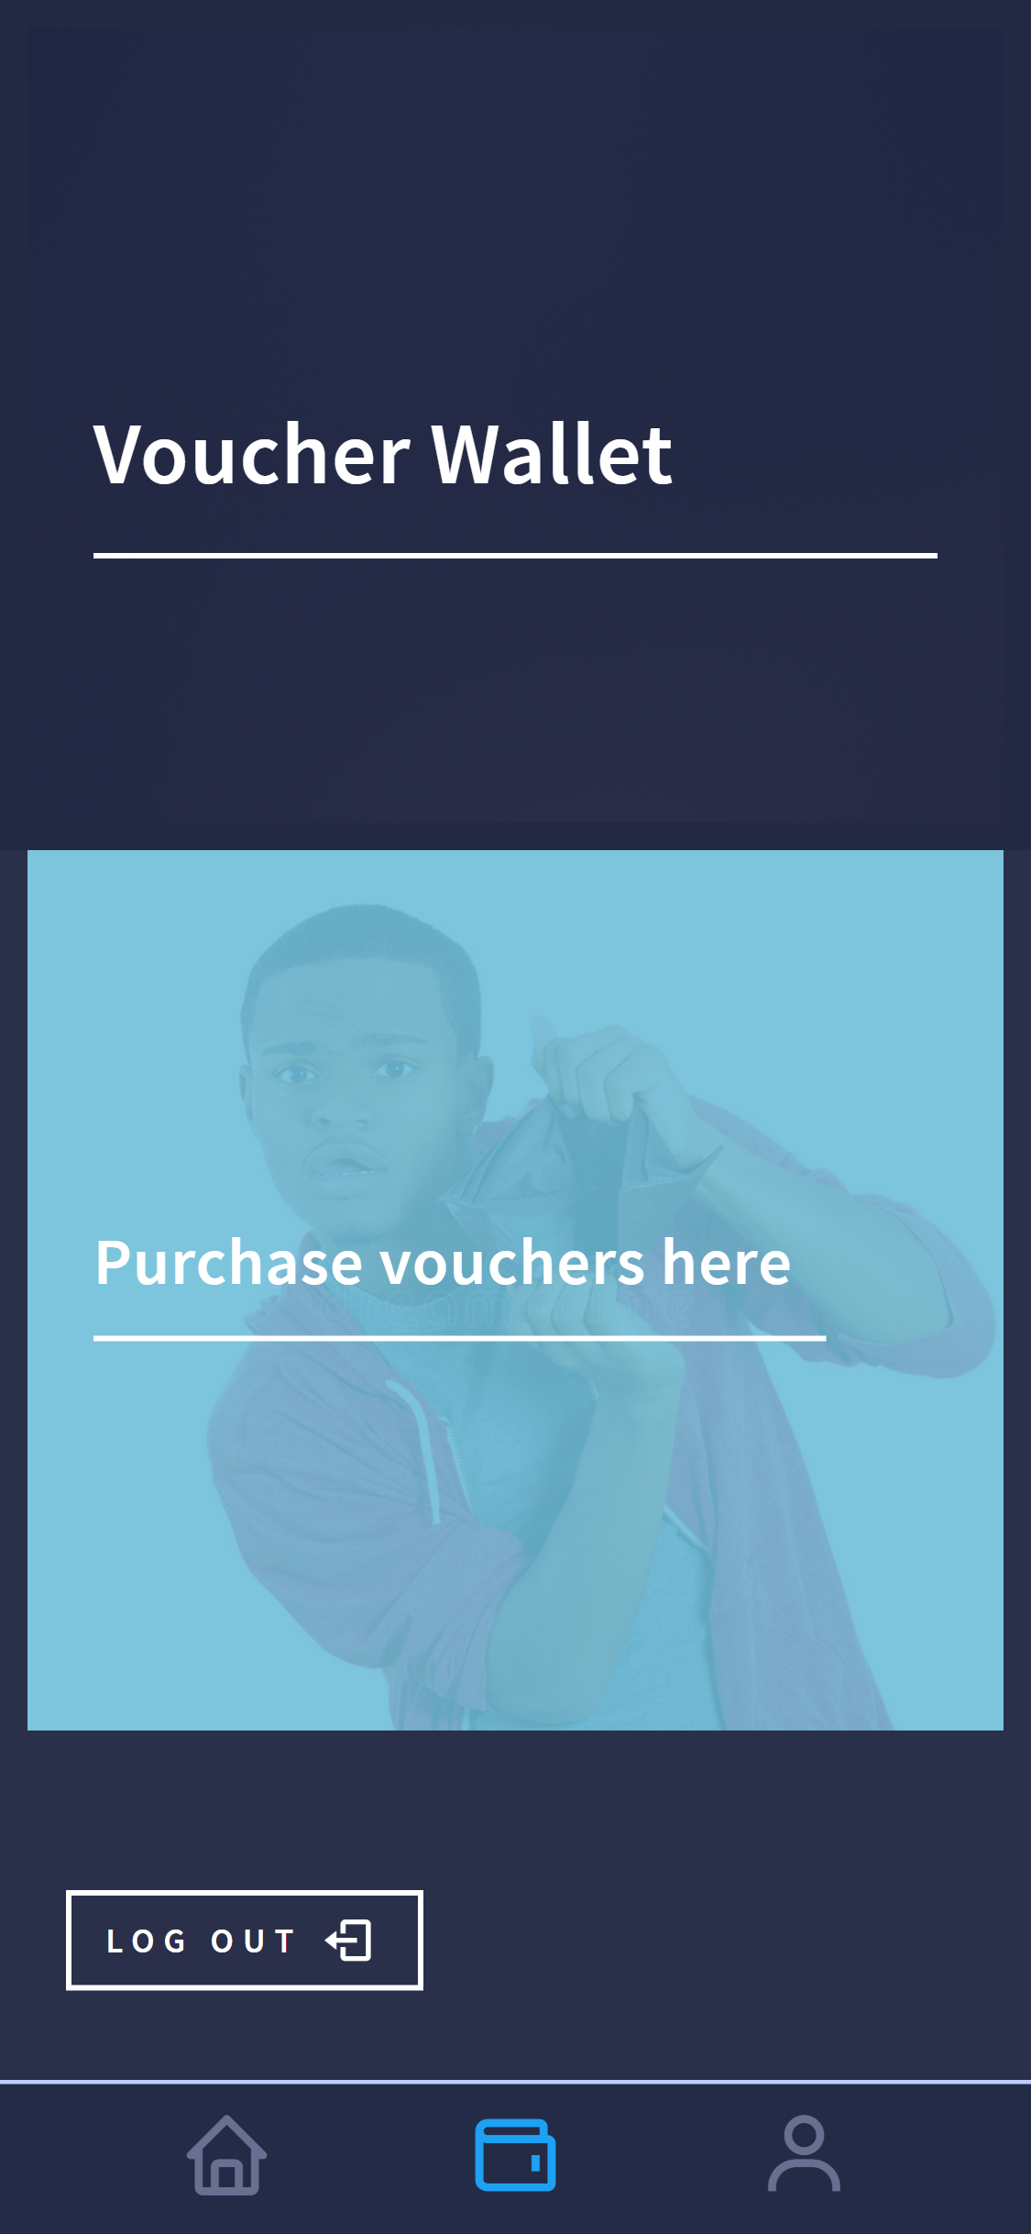
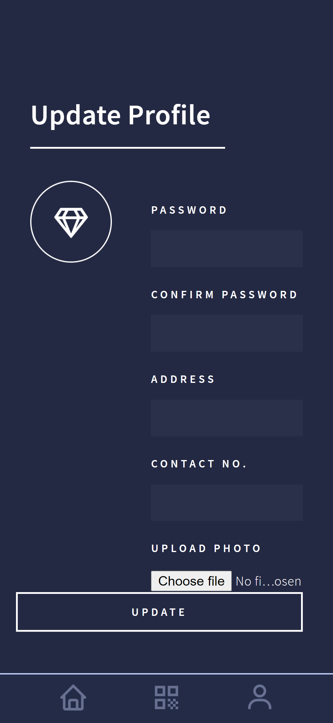
Introducing
ShopSave
user
vendor
Problem
Statement
UI Preview
landing page
For consumers to begin their user journey
Notes:
UI
Tech

Slide 7


Problem
Statement
UI Preview
Notes:
UI
Tech

Slide 8
Notes:
UI
Tech

Slide 9
Notes:
UI
Tech

Slide 10
Notes:
UI
Tech

Slide 11

Introducing
ShopSave
landing
registration
user
vendor
landing page
For consumers to begin their user journey
Notes:
UI
Tech

Slide 12
Introducing
ShopSave
landing
registration
login
user
vendor
registration
Fuss free registration
Notes:
UI
Tech

Slide 13
Introducing
ShopSave
registration
login
home
user
vendor
login
‘nuff said
Notes:
UI
Tech

Slide 14
Introducing
ShopSave
login
home
vouchers
user
vendor
home page
Discover the latest promotions from
various stores
Notes:
UI
Tech

Slide 15
Introducing
ShopSave
home
vouchers
wallet
user
vendor
purchasing vouchers
Check out the vouchers from your favourite stores!
Notes:
UI
Tech

Slide 16
Introducing
ShopSave
vouchers
wallet
qr
user
vendor
voucher wallet
Check out your neat collection of vouchers
Notes:
UI
Tech

Slide 17
Introducing
ShopSave
vouchers
wallet
qr
user
vendor
voucher wallet
Check out your neat collection of vouchers
Notes:
UI
Tech

Slide 18
Introducing
ShopSave
wallet
qr
user
vendor
voucher qr
Check out your neat collection of vouchers
Notes:
UI
Tech

Slide 19
Introducing
ShopSave
wallet
qr
user
vendor
voucher qr
Check out your neat collection of vouchers
Notes:
UI
Tech

